Slide 1
Magnetic Resonance Imaging homework III Adviser : JTENG-YI Hwang Reporter ：HSIN-YU CHEN
講師 課程

Slide 2
Outline
Equation
Introduction
Code
Result
Notes:
秘訣：在這裡新增演講者備忘稿。

Slide 3

Equation
$M(t)=X_{0}(1−e^{{−TI}/{T_{1}}})$
$M(t)=$ $X_{0}(1−e^{{−TI}/{T_{2}}})$

Slide 4
Introduction
NumPy-快速處理數據
matplotlib的pyplot子庫提供了和matlab類似的繪圖API，方便用戶快速繪製2D圖表
scipy.optimize.curve_fit ─ Use non-linear least squares to fit a function, f, to data.
numpy.zeros ─ Return a new array of given shape and type, filled with zeros.
Notes:
秘訣：在這裡新增演講者備忘稿。

Slide 5
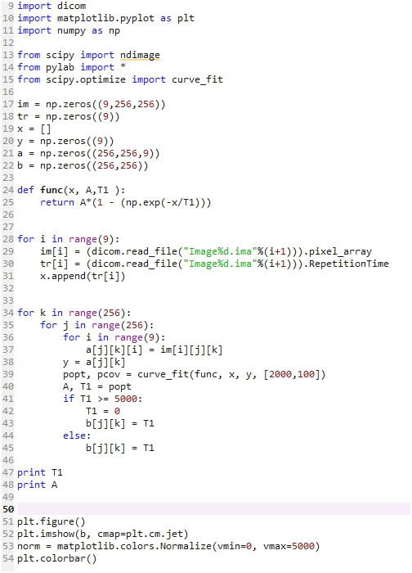
T1 fitting

Slide 6
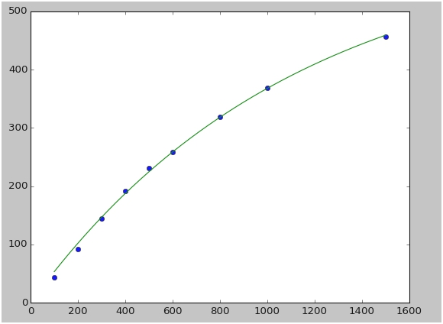
Result 1

Slide 7
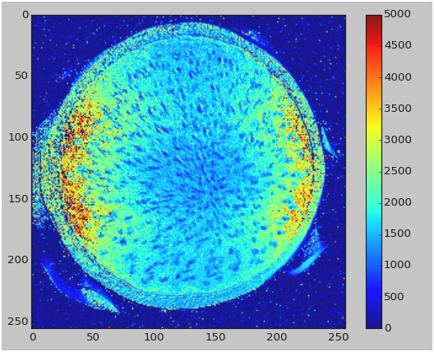
Result 1

Slide 8
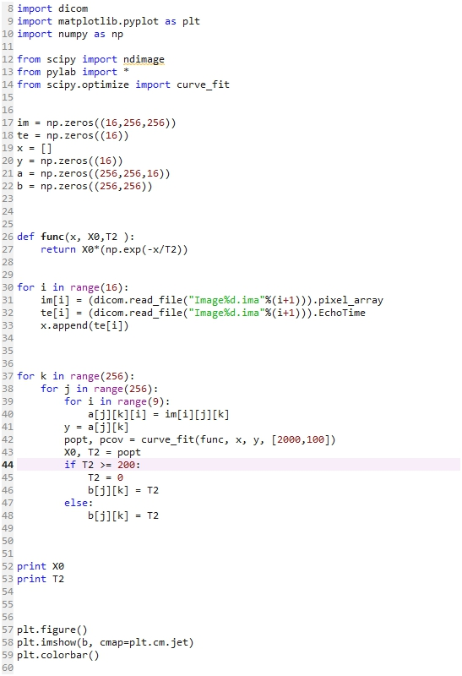
T2 fitting
Notes:
秘訣：在這裡新增演講者備忘稿。

Slide 9
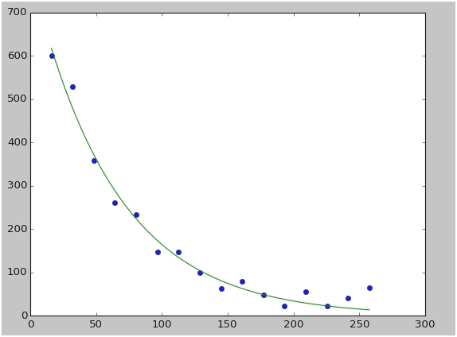
Result 11

Slide 10
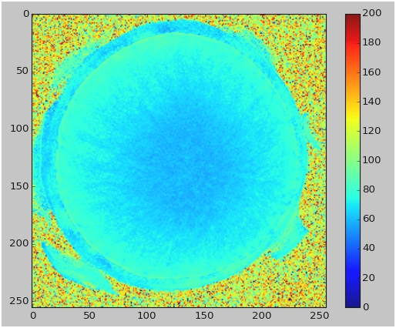
Result 11
Notes:
秘訣：在這裡新增演講者備忘稿。

Slide 11
Thanks for your attention

